Slide 1

Chapter 19 – Microbial Taxonomy and the Evolution of Diversity

Slide 2
19.1 Microbial Taxonomy is Based on the Evolution of Multiple Traits
Explain the utility of taxonomy and systematics
Draw a concept map illustrating the differences between phenetic, phylogenetic, and genotypic classification

Slide 3
Introduction to Microbial Taxonomy
Taxonomy
science of biological classification
consists of three separate but interrelated parts
classification – arrangement of organisms into groups (taxa; s., taxon)
nomenclature – assignment of names to taxa
identification – determination of taxon to which an isolate belongs

Slide 4
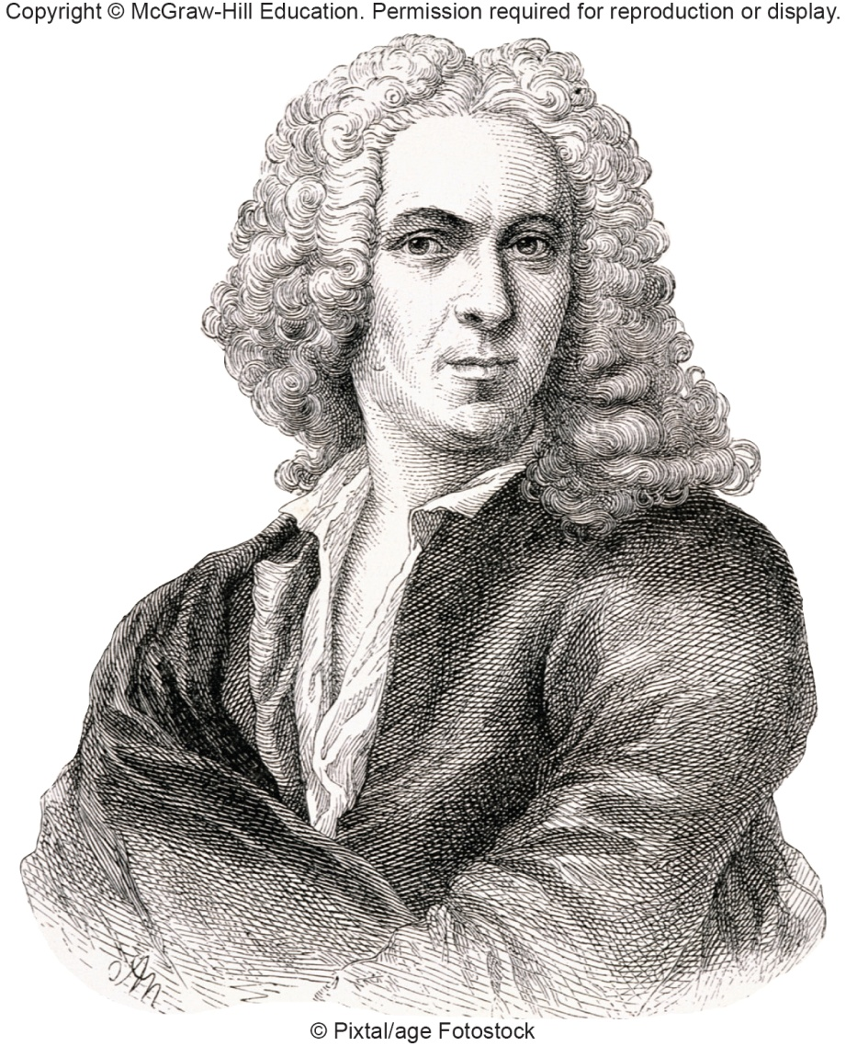
Natural Classification
Arranges organisms into groups whose members share many characteristics
first such classification in 18th century developed by Linnaeus
based on anatomical characteristics
This approach to classification does not necessarily provide information on evolutionary relatedness

Slide 5
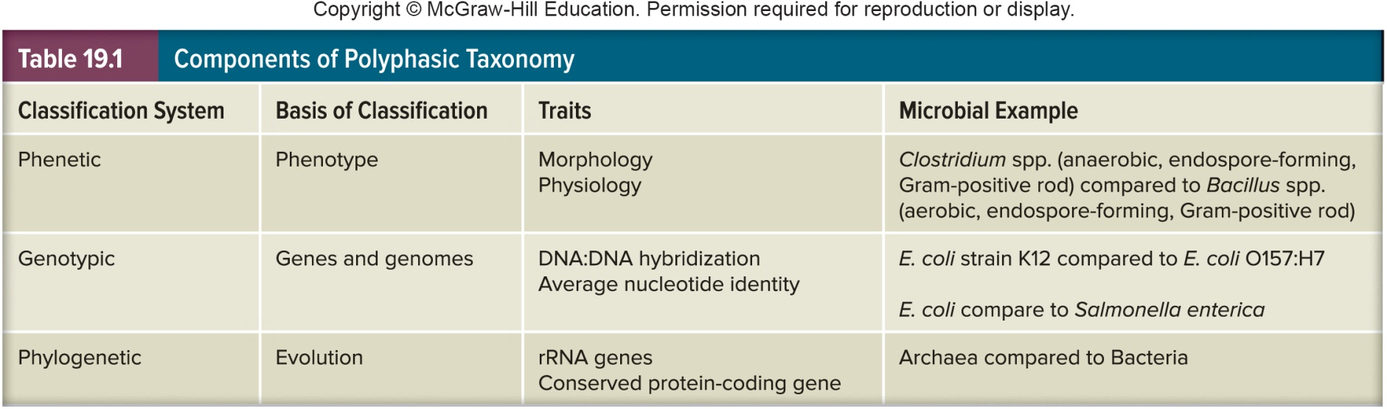
Polyphasic Taxonomy
Used to determine the genus and species of a newly discovered prokaryote
Incorporates information from genetic, phenotypic, and phylogenetic analysis

Slide 6
Phenetic Classification
Groups organisms together based on mutual similarity of phenotypes
Can reveal evolutionary relationships, but not dependent on phylogenetic analysis
i.e., doesn’t weigh characters
Best systems compare as many attributes as possible

Slide 7
Genotypic Classification
Comparison of genetic similarity between organisms
individual genes or whole genomes can be compared
70% homologous belong to the same species

Slide 8
Phylogenetic Classification
Also called phyletic classification systems
Phylogeny
evolutionary development of a species
Usually based on direct comparison of genetic material and gene products
Woese and Fox proposed using small subunit (SSU) rRNA nucleotide sequences to assess evolutionary relatedness of organisms

Slide 9
19.2 Taxonomic Ranks Provide an Organizational Framework
Outline the general scheme of taxonomic hierarchy
Explain how the binomial system of Linnaeus is used in microbial taxonomy

Slide 10
Taxonomic Ranks
Microbes are placed in hierarchical taxonomic levels with each level or rank sharing a common set of specific features
Highest rank is domain
Bacteria and Archaea – microbes only
Eukarya – microbes and macroorganisms
Within domain
phylum, class, order, family, genus, species epithet, some microbes have subspecies

Slide 11
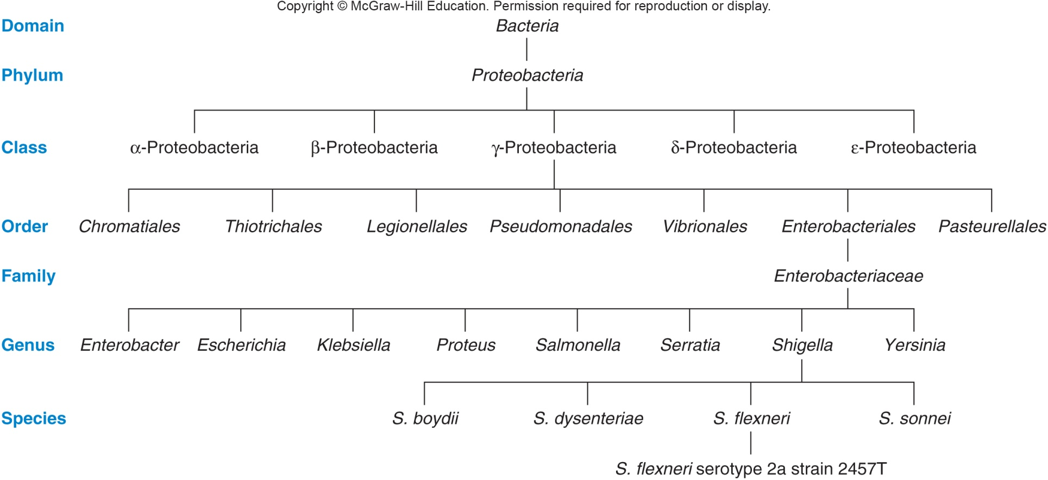
Heirarchical Arrangement in Taxonomy

Slide 12
Species
Definition
collection of strains that share many stable properties and differ significantly from other groups of strains
Also suggested as a definition of species
collection of organisms that share the same sequences in their core housekeeping genes

Slide 13
Strains
Descended from a single, pure microbial culture
Vary from each other in many ways
biovars – differ biochemically and physiologically
morphovars – differ morphologically
serovars – differ in antigenic properties

Slide 14
Type Strain
Usually one of first strains of a species studied
Often most fully characterized
Not necessarily most representative member of species

Slide 15
Genus
Well-defined group of one or more strains
Clearly separate from other genera
Often disagreement among taxonomists about the assignment of a specific species to a genus

Slide 16
Binomial System of Nomenclature
Devised by Carl von Linné (Carolus Linnaeus)
Each organism has two names
genus name – italicized and capitalized (e.g., Escherichia)
species epithet – italicized but not capitalized (e.g., coli)
Can be abbreviated after first use (e.g., E. coli)
A new species cannot be recognized until it has been published in the International Journal of Systematic and Evolutionary Microbiology

Slide 17
19.3 Microbial Taxonomy and Phylogeny Are Largely Based on Molecular Characterization
Construct a concept map describing the approaches commonly used to determine taxonomic classification
Assess the impact molecular methods have had on the field of microbial taxonomy and phylogeny
Compare and contrast nucleotide sequencing and non-sequencing based molecular approaches used in microbial taxonomy and phylogeny
Select an appropriate technique to identify a microbial genus, species, and strain
Predict the basic biological as well as public health implications of microbial taxonomic identification

Slide 18
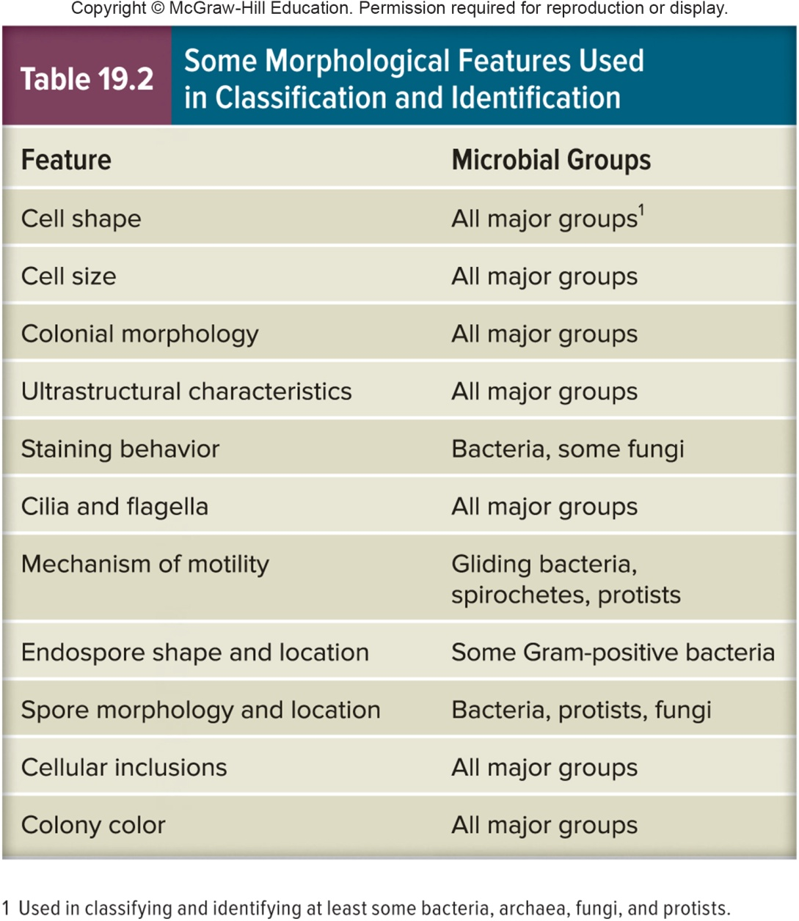
Techniques for Determining Microbial Taxonomy and Phylogeny
Classical characteristics
morphological
physiological
biochemical
ecological
genetic

Slide 19
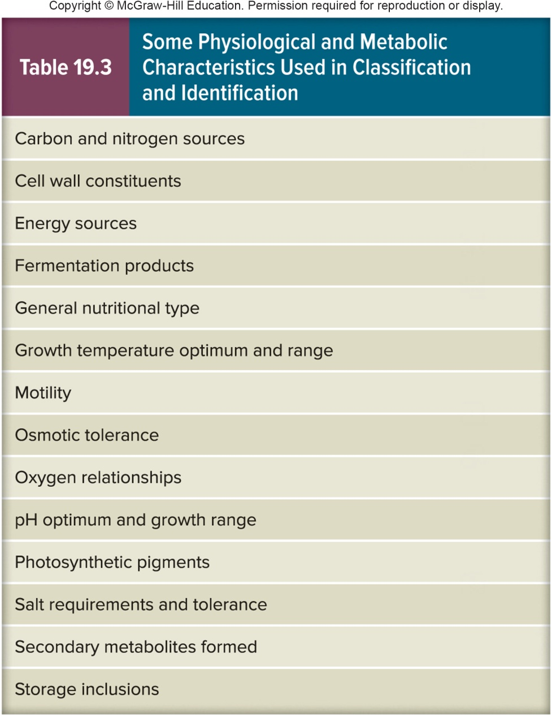
Physiological and Metabolic Characteristics for Identification and Classification

Slide 20
Ecological Characteristics
Life-cycle patterns
Symbiotic relationships
Ability to cause disease
Habitat preferences
Growth requirements

Slide 21
Molecular Approaches
Extremely important because almost no fossil record was left by microbes
Allows for the collection of a large and accurate data set from many organisms
Phylogenetic inferences based on these provide the best analysis of microbial evolution currently available
Molecular characteristics for identification and classification
nucleic acid base composition
nucleic acid hybridization
nucleic acid sequencing
genomic fingerprinting

Slide 22
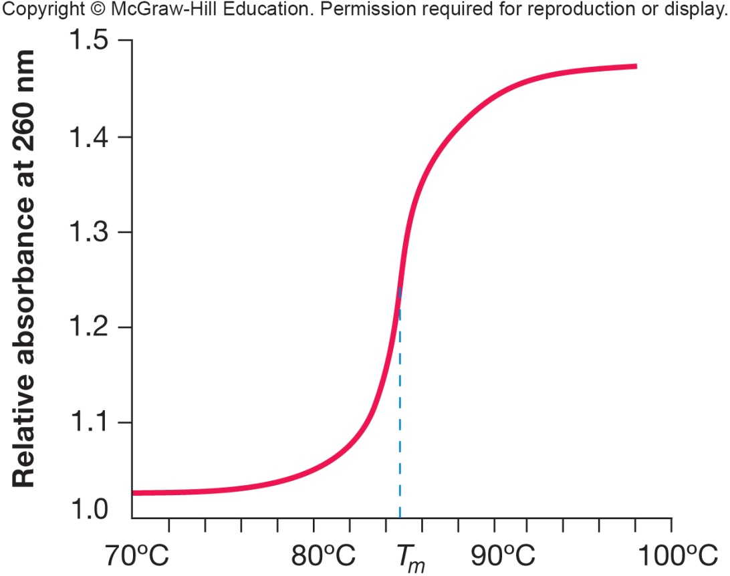
Nucleic Acid Base Composition
G + C content
Mol% G + C = (G + C/G + C + A + T)100
usually determined from melting temperature (T_{m})
variation within a genus usually <10%

Slide 23
Nucleic Acid Hybridization
DNA-DNA hybridization
measure of sequence homology
Common procedure
bind nonradioactive DNA to nitrocellulose filter
incubate filter with radioactive single-stranded DNA
measure amount of radioactive DNA attached to filter

Slide 24
Nucleic Acid Sequencing
Small subunit rRNAs (SSU rRNAs)
sequences of 16S and 18S rRNA most powerful and direct method for inferring microbial phylogenies and making taxonomic assignments at genus level
Comparative Analysis of 16S rRNA Sequences
oligonucleotide signature sequences found
short conserved sequences specific for a phylogenetically defined group of organisms
either complete or, more often, specific rRNA fragments can be compared
when comparing rRNA sequences between 2 organisms, their relatedness is represented by percent sequence homology
70% is cutoff value for species definition

Slide 25
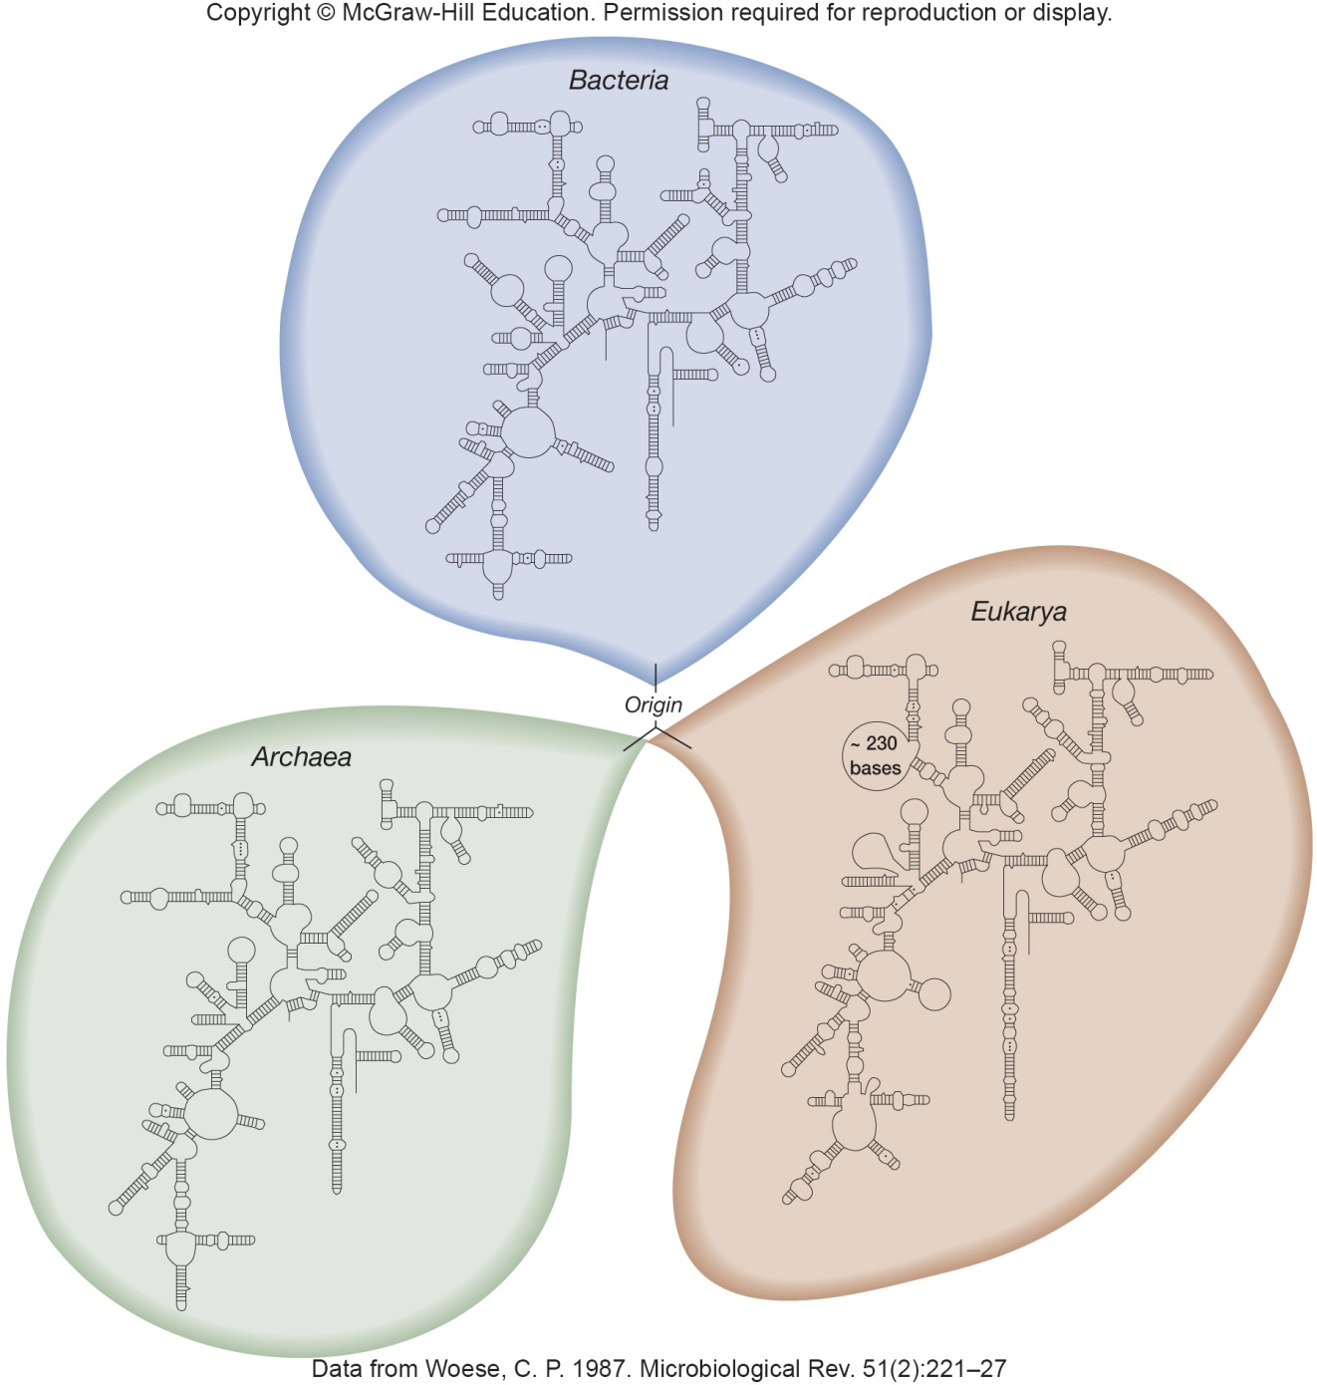
Small Ribosomal Subunit RNA

Slide 26
Genomic Fingerprinting
Used for microbial classification and determination of phylogenetic relationships
Requires analysis of genes that evolve more quickly than rRNA encoding genes
multilocus sequence analysis (MSLA)
the sequencing and comparison of 5 to 7 housekeeping genes is done to prevent misleading results from analysis of one gene
multilocus sequence typing (MLST)
discriminates among strains

Slide 27
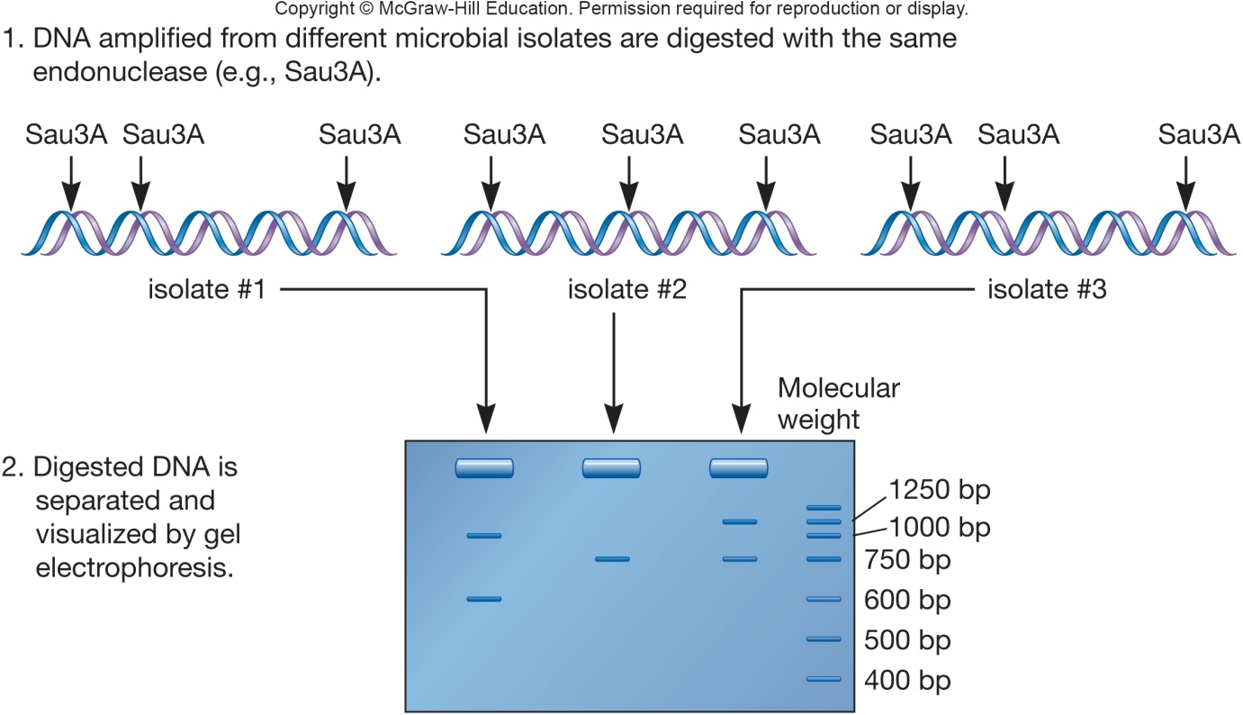
Restriction Fragment Length Polymorphism (RFLP)
Uses restriction enzymes to recognize specific nucleotide sequences
cleavage patterns are compared
Ribotyping
similarity between rRNA genes determined by RFLP

Slide 28
Single Nucleotide Polymorphism (SNP)
Looks at single nucleotide changes, or polymorphisms, in specific genes
16S rRNA focuses on one specific gene
Regions targeted because they are normally conserved, so single changes in a base pair reveal evolutionary change

Slide 29
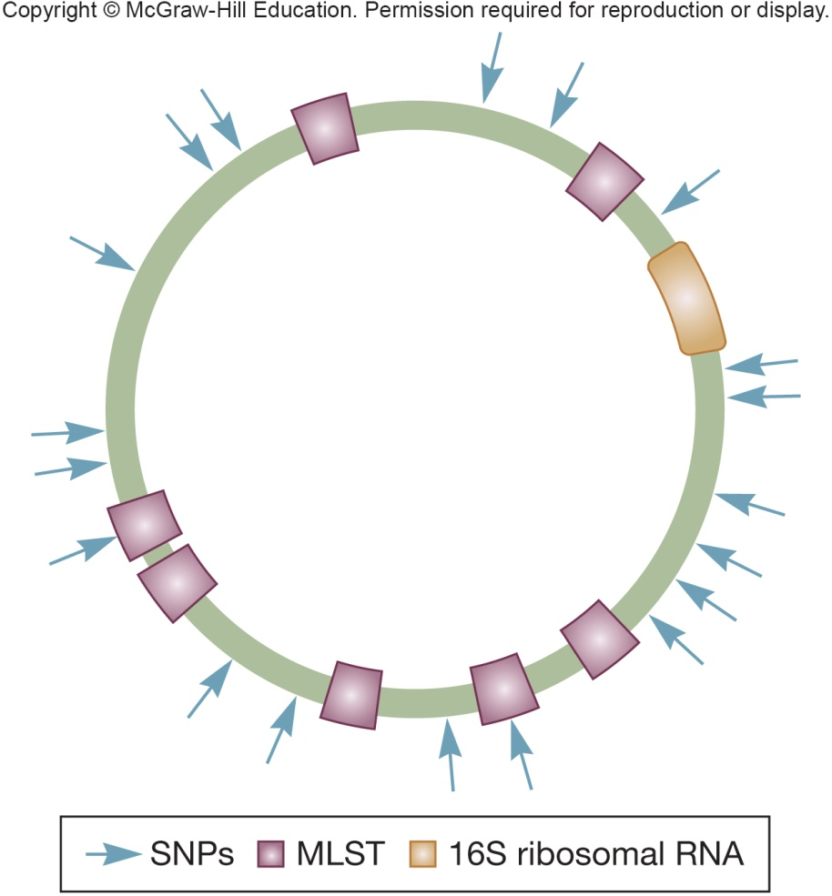
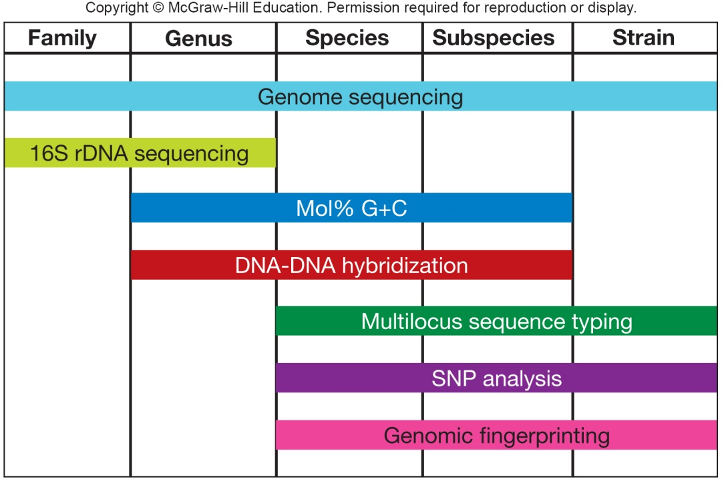
Comparison of Resolution/Coverage of Genotyping Approaches

